Slide 1
Credit Card Financial Dashboard
An Interactive Analysis of Transaction & Customer Insights
Nibedita Sahu
Data Science & Analytics

Slide 2
Project Objective
The objective of this project is to build an interactive and insightful dashboard using Power BI that helps in analyzing:
Customer behaviours based on their demographics and usage patterns.
Transaction trends across various card types and usage methods.
Revenue and Interest metrics from a financial performance perspective.
This dashboard enables a data-driven understanding of credit card usage, aiding business decisions and improving customer targeting.

Slide 3
Data Overview
The dataset was sourced from an open dataset available online, which includes a variety of features around credit card transactions and customer profiles.
Dataset Highlights:
Transactions: 656K
Income: 576M
Customer Satisfaction Score: 3.19
Key Fields:
Card Category, Gender, Age, Income Group
Revenue, Interest Earned, Transaction Volume
Education, Job, Risk Level, Marital Status

Slide 4
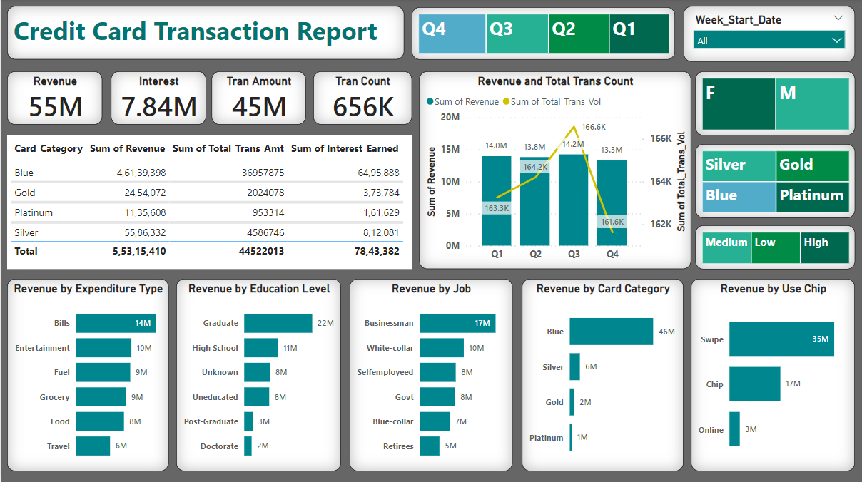

Slide 5
Transaction Report
Dashboard Structure
This report focuses on the financial aspect of credit card transactions. It provides a broad view of how revenue and transaction volumes vary across different dimensions.
Key Elements:
KPI Cards: Overall Revenue, Interest, Transaction Amount & Count
Card Categories: Blue, Gold, Platinum, Silver
Trends: Revenue & Transaction Volume by Quarter
Demographics & Usage Analysis:
Revenue by Job, Education, Card Category, and Use Type
Expenditure Types and their revenue contributions
The report is prepared with slicers for Quarter, Gender, Card Type, Income Group, and Start Date of Week to enable dynamic filtering.

Slide 6
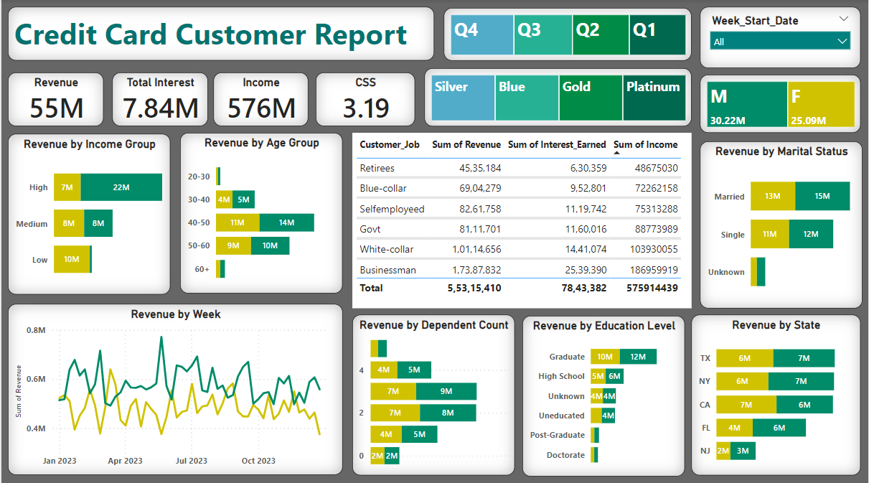

Slide 7
Customer Report
Dashboard Structure
This report highlights the customer profile side of credit card usage. It helps understand which customer groups are contributing more to revenue and how usage patterns vary.
Key Elements:
KPI Cards: Revenue, Interest, Income, and CSS (Customer Satisfaction Score)
Customer Segment Table: Job-wise Revenue, Interest, and Income
Behavioural Patterns:
Revenue by Age, Income Group, Marital Status, Education, Dependents, and State
Revenue trends over Week
Slicers are available for Quarter, Gender, Card Type, and Start Date of Week, providing interactive filtering.

Slide 8
Key Metrics
Our dashboard presents key performance indicators that provide a quick snapshot of the credit card business performance. These metrics are displayed as KPI cards across both reports for quick analysis.
💰 Financial Metrics:
Total Revenue: 55M
Total Interest Earned: 7.84M
Total Transaction Amount: 45M
Total Income: 576M
📈 Volume Metrics
Transaction Count: 656K
Customer Satisfaction Score (CSS): 3.19

Slide 9
Key Metrics
📊 Filter Capabilities
Both reports allow filtering based on:
Time Period (Quarter / Start Date of Week)
Demographics (Gender, Marital Status, Education)
Financial Attributes (Card Category, Income Group)
These filters help in analyzing KPIs across different customer segments and time frames.

Slide 10
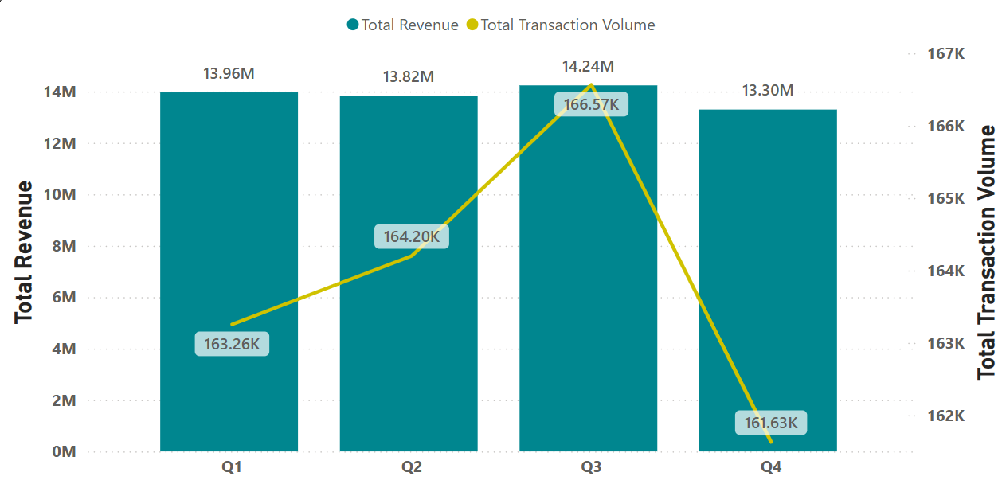
Quarter-wise Revenue & Transaction Volume
Both Revenue and Transaction Volume peaked in Q3 with 14.24M and 166.57K respectively. This shows strong seasonal performance. A consistent upward trend indicates positive business growth.

Slide 11
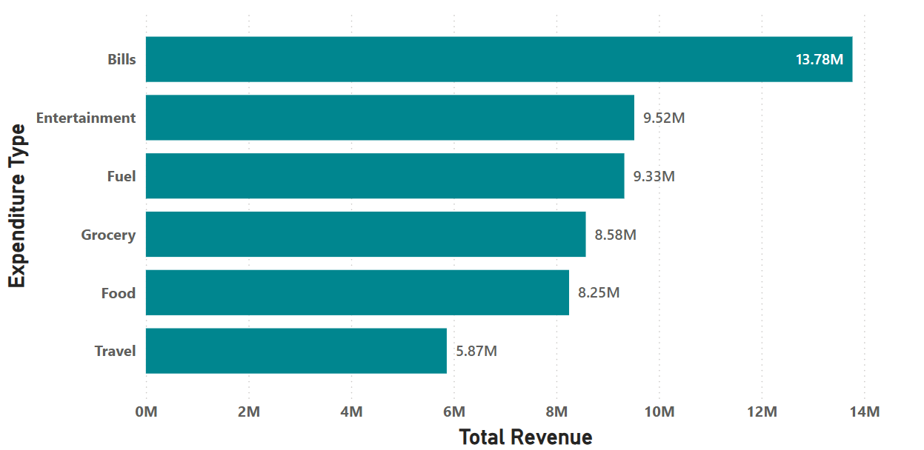
Revenue by Expenditure Type
Bills lead the way as the top spending category, contributing over $13.78 Million in revenue. Following closely, Entertainment and Fuel also show strong performance, generating $9.52 Million and $9.33 Million respectively. These categories are key drivers of revenue growth.

Slide 12
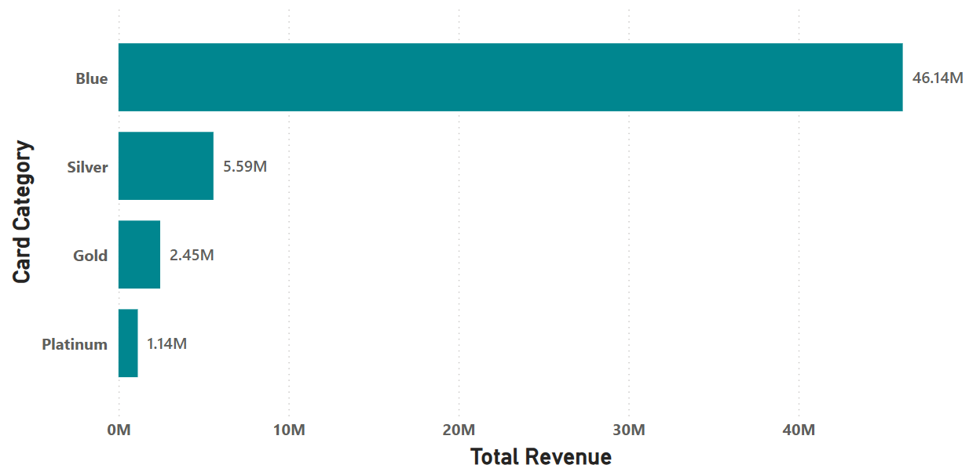
Revenue by Card Category
Blue cards dominate revenue, contributing over $46.14 Million, far surpassing the other card types. Silver, Gold, and Platinum cards contribute significantly less, with $5.59 Million, $2.45 Million, and $1.14 Million respectively.

Slide 13
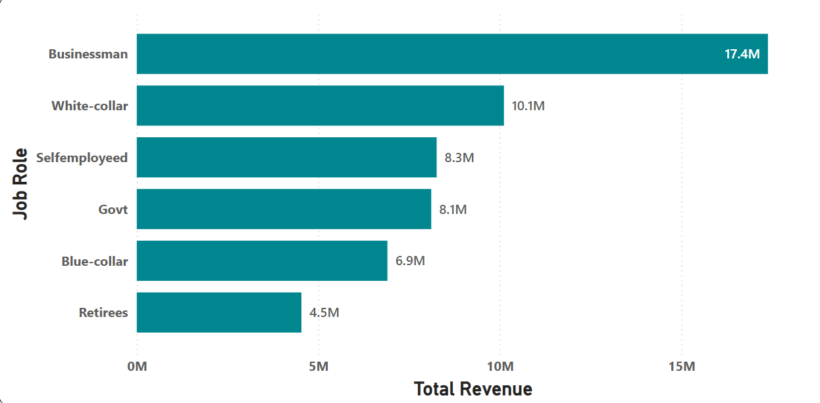
Revenue by Job
Businessman leads with $17.4M in revenue, significantly outpacing other job roles. White-collar contribute $10.1M, while Retirees contribute the least at $4.5M.

Slide 14

Revenue by Job
Men generated $30.22M in revenue, while women generated $25.09M. This indicates that men contribute about 17% more to the total revenue than women. To increase revenue, marketing efforts should be targeted toward women.

Slide 15
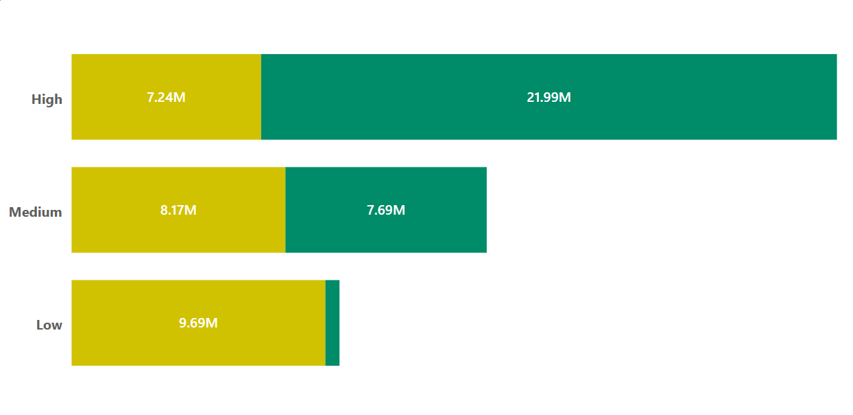
Revenue by Job
High-income group dominates overall revenue, driven primarily by Males ($21.99M), while Females contribute $7.24M. In the Medium-income group, Females slightly outperform Males. Among the Low-income group, Females show a significantly higher contribution ($9.69M) compared to Males.

Slide 16
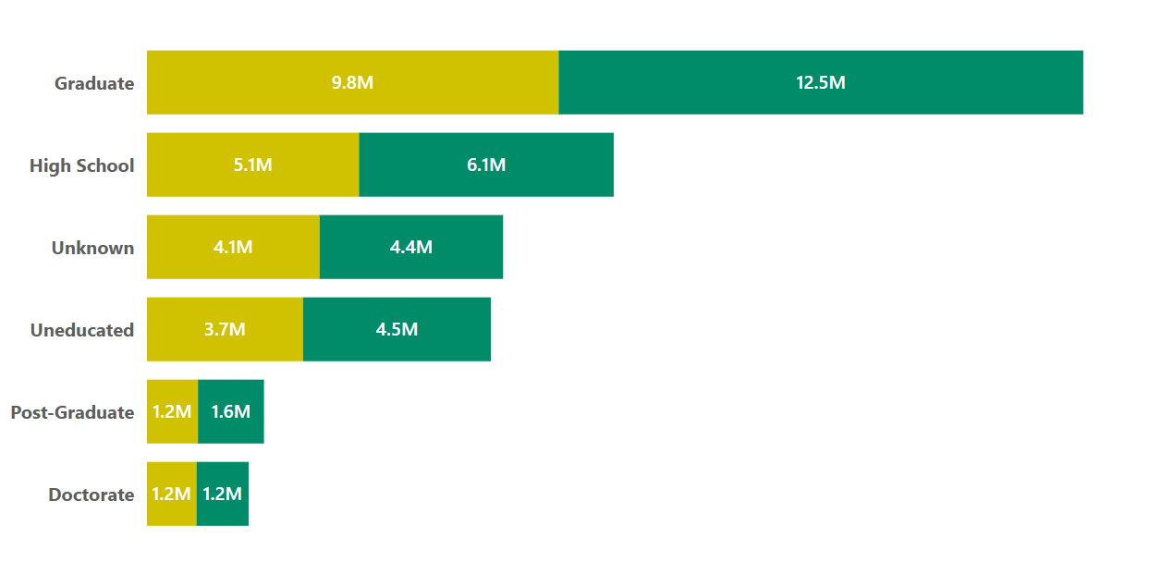
Revenue by Education Level
Graduates lead in revenue, with Males contributing $12.5M and Females $9.8M. High School level follows, with a near-equal gender split ($6.1M Males, $5.1M Females). Post-Graduate and Doctorate levels show the lowest revenue, with similar contributions from both genders.

Slide 17
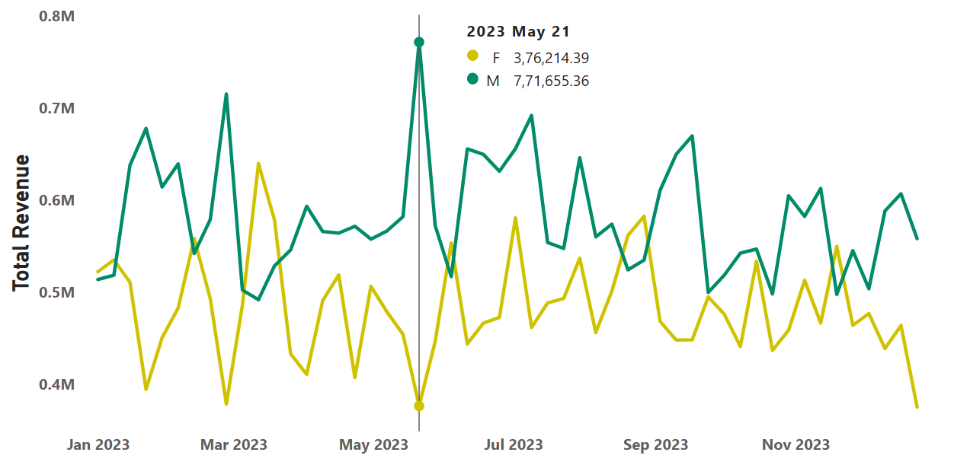
Weekly Revenue Trend
Weekly revenue peaked on May 21, 2023, with Male revenue at $7.71M and Female revenue at $3.76M. Overall, Male revenue consistently exceeds Female revenue. While there are fluctuations, the revenue trend remains relatively stable throughout the year, without major spikes or drops outside of the peak week.

Slide 18
Key Insights from Transaction Report
Revenue and transaction volume both peaked in Q3, showing strong seasonal performance.
Bills were the top expenditure type, followed by Entertainment and Fuel.
Blue Cards dominated revenue generation, far ahead of other card types.
Businessmen contributed the most by job category, followed by White-collar workers.
Overall, Men generated more revenue than Women, contributing about 17% more.

Slide 19
Key Insights from Customer Report
High-income customers, especially Males ($21.99M), contributed the most to revenue, compared to Females (7.24M).
In the medium-income group, Females slightly outperformed Males.
Among low-income customers, Females (9.69M) showed a significantly higher contribution than Males (539K).
Graduates led in revenue across education levels, again with Males (12.49M) significantly ahead, compared to Females (9.80M).
Weekly trend shows stable revenue throughout the year, peaking on May 21, 2023, with consistent Male dominance in revenue.

Slide 20
Business Value
Identified top-performing customer segments like, Businessmen, High-income earners, Graduates for focused marketing strategies.
Revealed Blue Card holders as the most valuable group, guiding future card promotion strategies.
Insights into spending behavior by category like, Bills, Entertainment, and Fuel can help tailor targeted cashback or loyalty programs.
Gender-based revenue analysis helps in designing campaigns aimed at increasing Female engagement, especially in underperforming segments.
Stable weekly revenue trend enables better forecasting and resource planning.

Slide 21
Conclusion
This project successfully shows how Power BI can be used to uncover deep insights from financial and customer data.
The dashboards offer clear visibility into key revenue drivers, customer behaviors, and transaction trends.
These insights can support data-driven decision-making across marketing, product strategy, and customer targeting.
The project reflects strong visual storytelling, efficient use of Power BI features, and an understanding of business context through analytics.

Slide 22
Thank You
Nibedita Sahu
That’s a wrap up — now let’s talk data!

